Slide 2
Enhancing Node Stability
Through Containerd and Kata Containers Interface Evolution
Peng Tao, Ant Group, Kata Containers Architecture Committee Member
Chao Wu, Alibaba Cloud, Kata Containers Maintainer

Slide 3


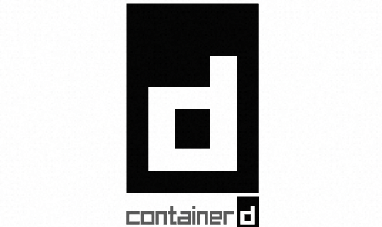

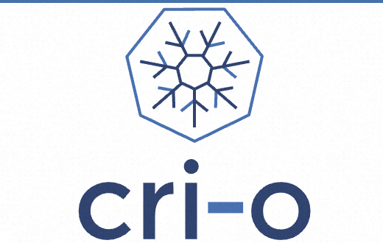
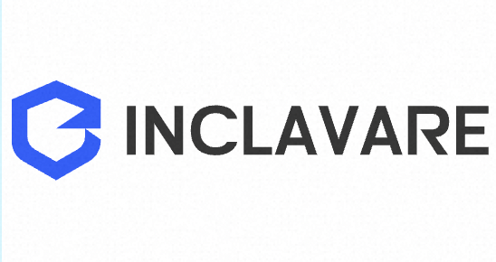
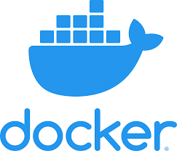
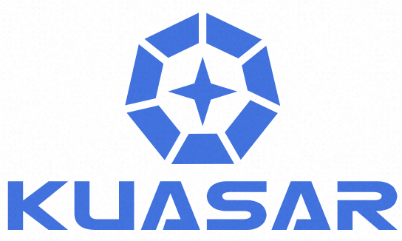

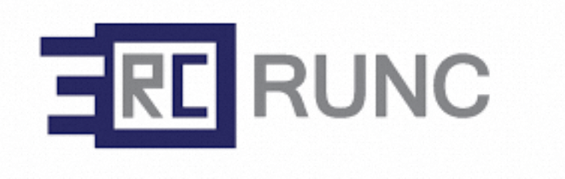
Container Runtime Universe
We have a whole universe of “container runtimes”…
But how do them work together?

Slide 4
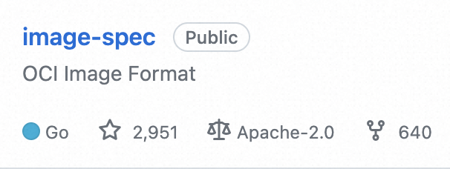
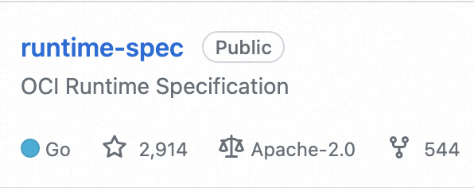
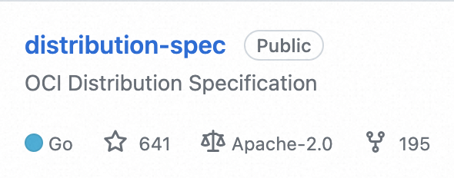
The story begins with the interfaces
We need a universal way
in container specification…
Here comes…
O
C
I
Industry
Open Container Initiative
…
Year 2015
OCI = Runtime + Image + Distribution Specification

Slide 5
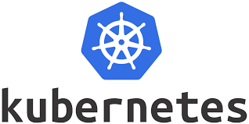
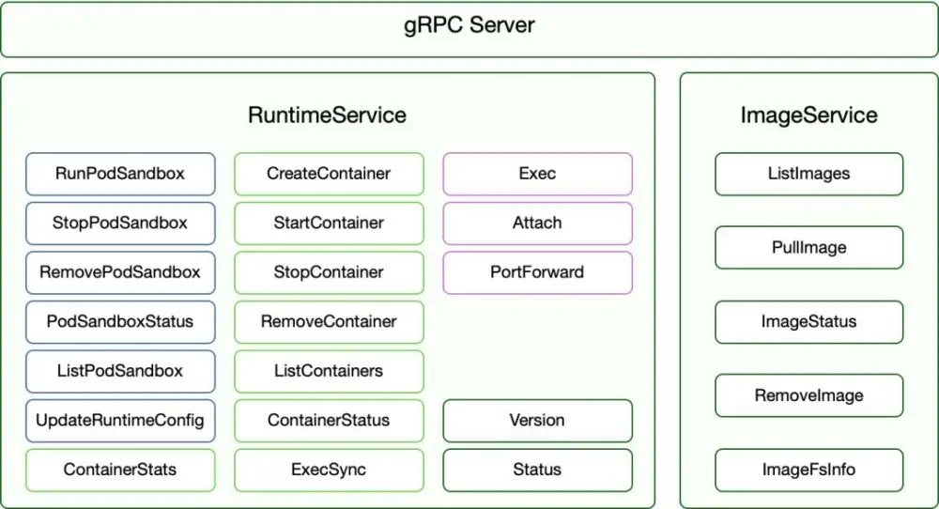
The story begins with the interfaces
I need a universal way
to manage containers…
Here comes…
C
R
I
Container Runtime Interface
Year 2016
CRI = Mgt Interface for Sandbox + Container + Image
Sandbox
Start first, end last. Isolated Pod Resource.
Acquire resource needed for running child containers
E.g. :
runc Container: Infra container + pod cgroup
Kata Container: Micro VM.

Slide 6
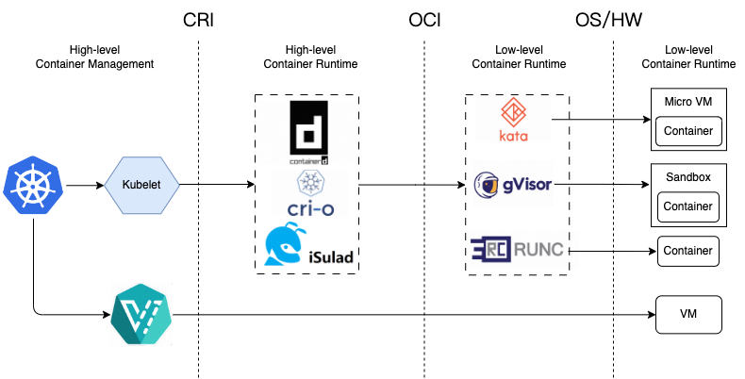
Interfaces define ecosystem

Slide 7
It’s all about interfaces
Let’s take a loot at the journey for
Containerd & Kata Containers Interface evolution

Slide 8
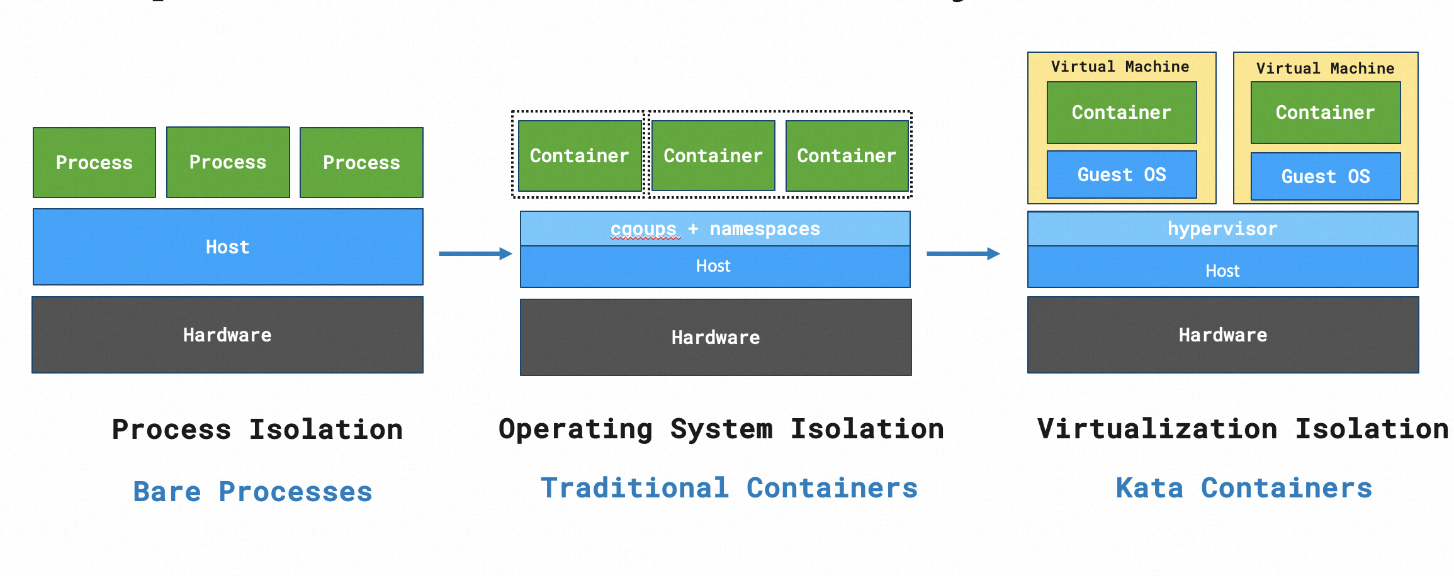
What is Kata Container?
Speed of containers, security of VMs

Slide 9
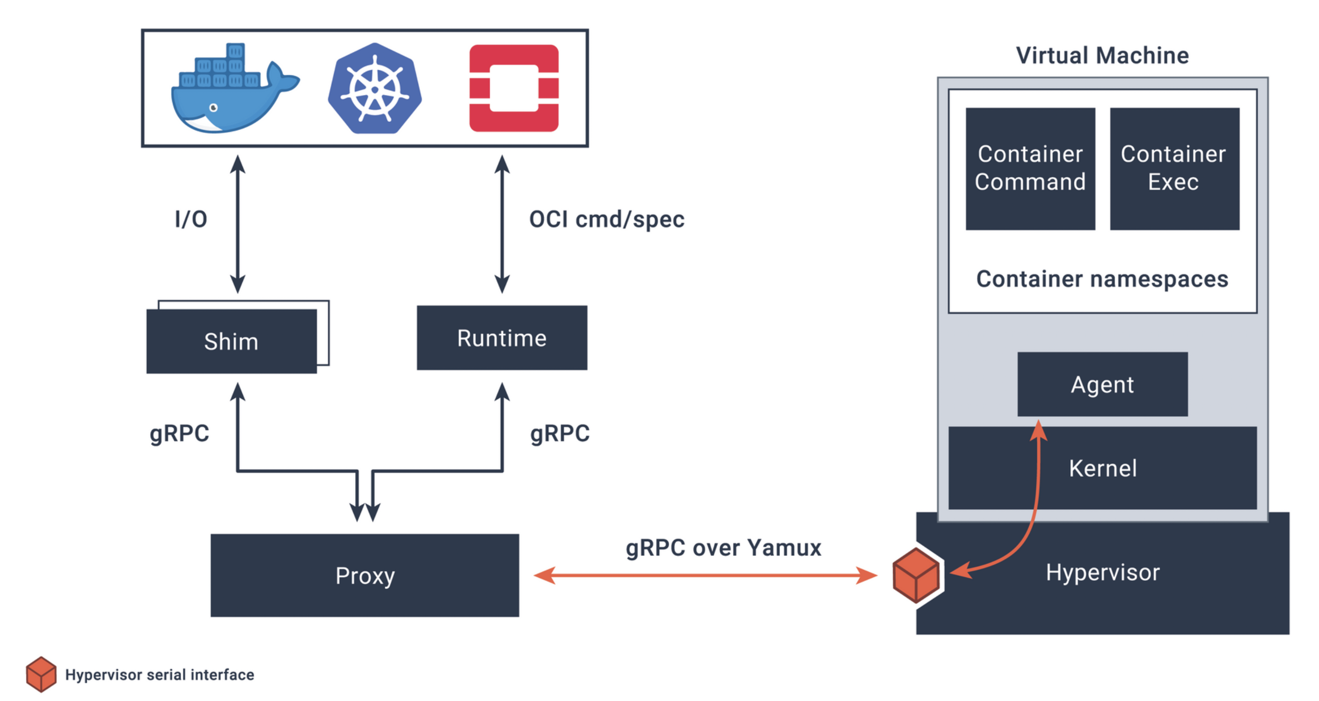
Once Upon A Time: Kata Initial Era (2017)

Slide 10
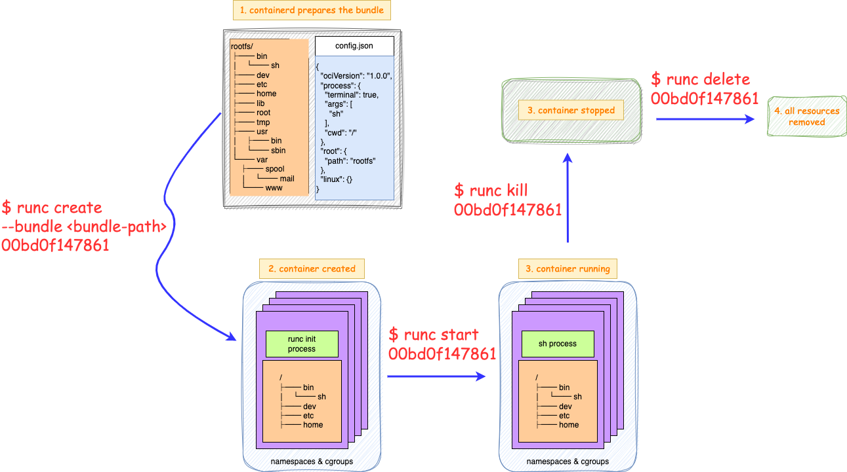
The Defacto OCI Runtime Spec: runc CLI

Slide 11

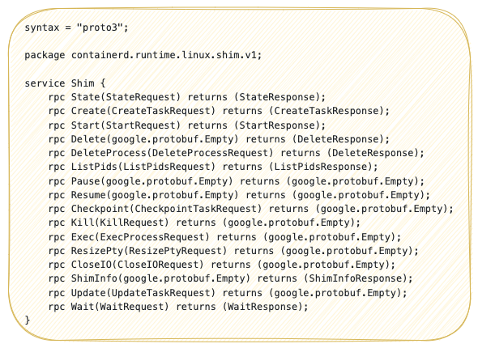

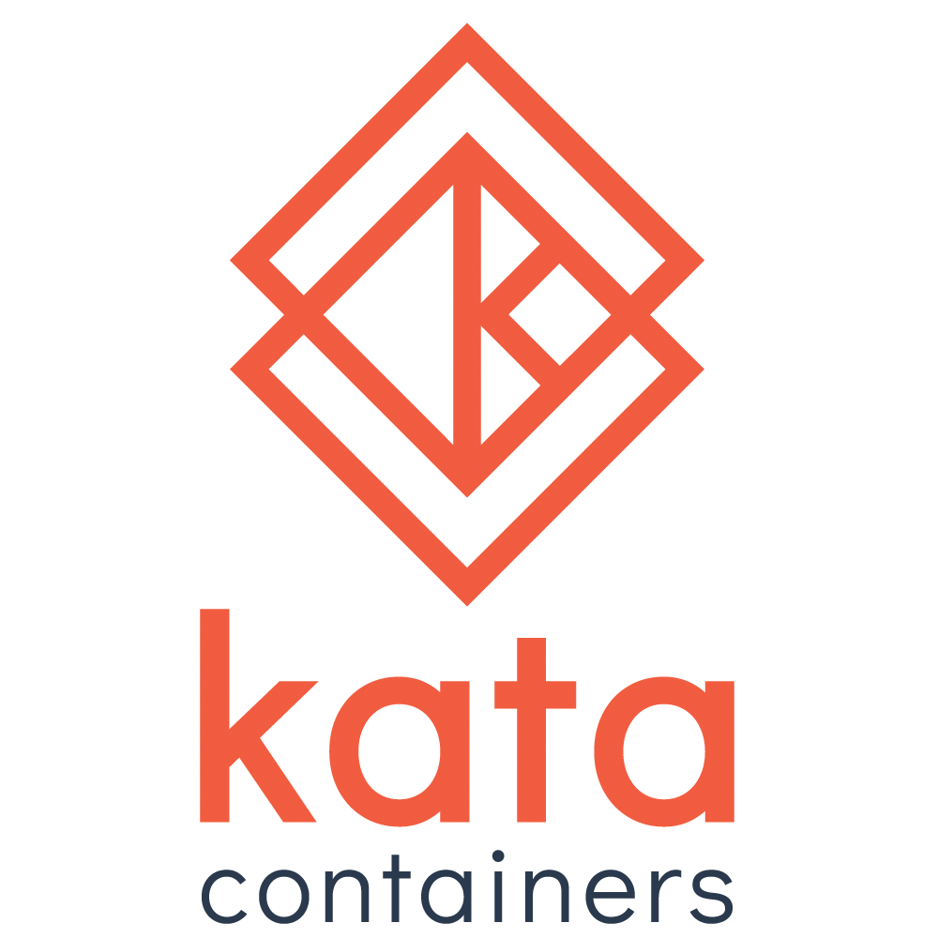
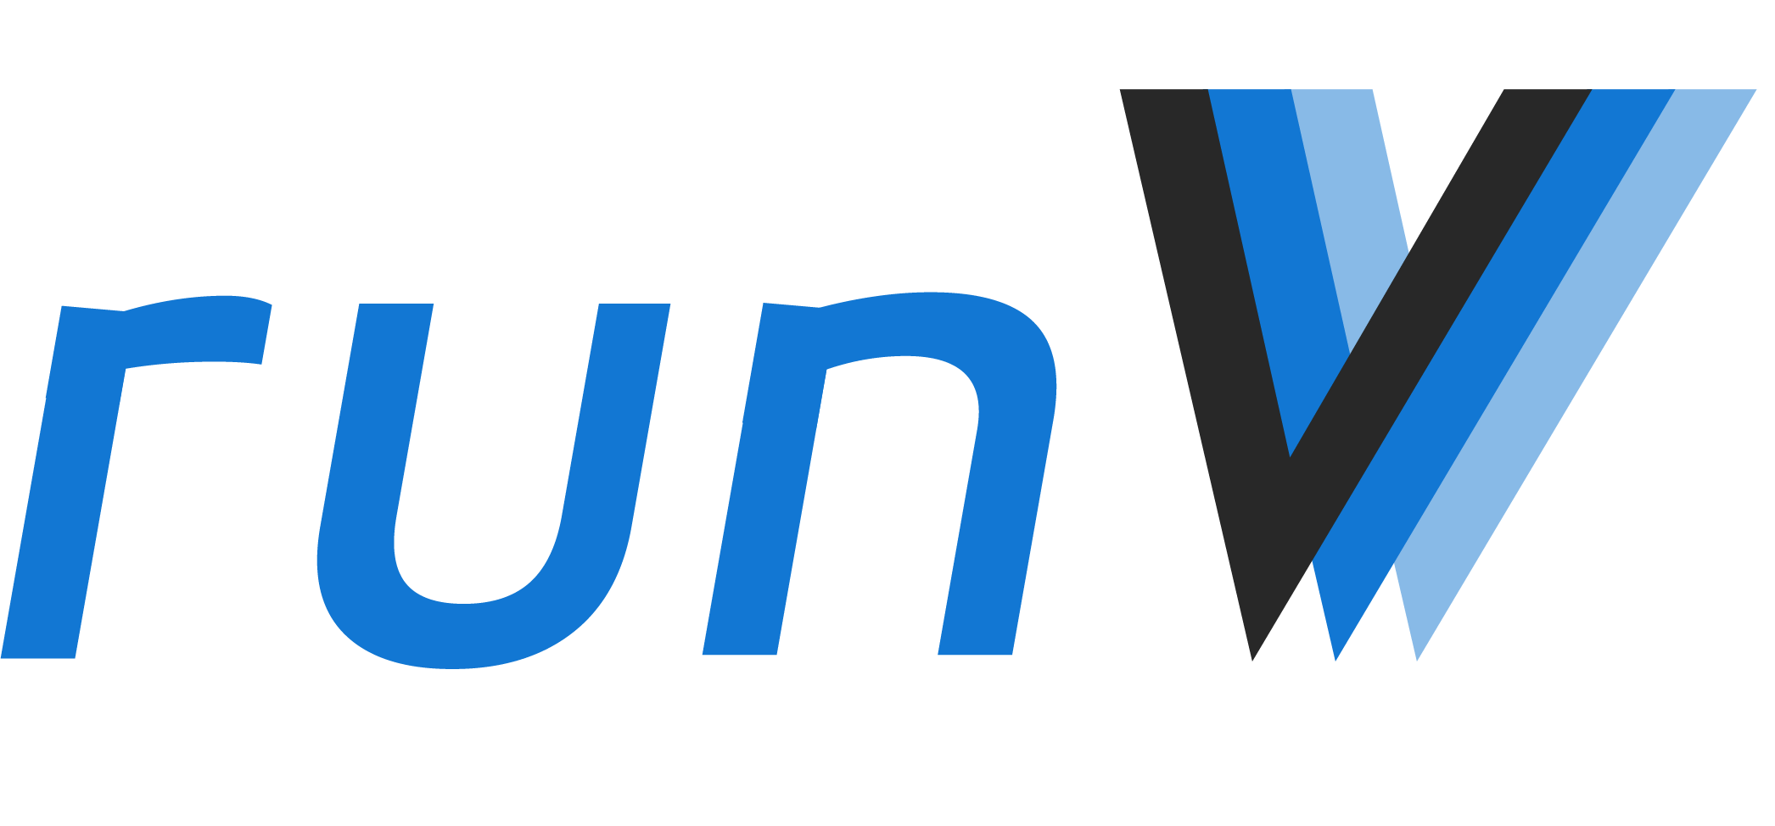
containerd shim + different runtimes
shim.v1.proto
containerd shim
runc CLI interfaces

Slide 12
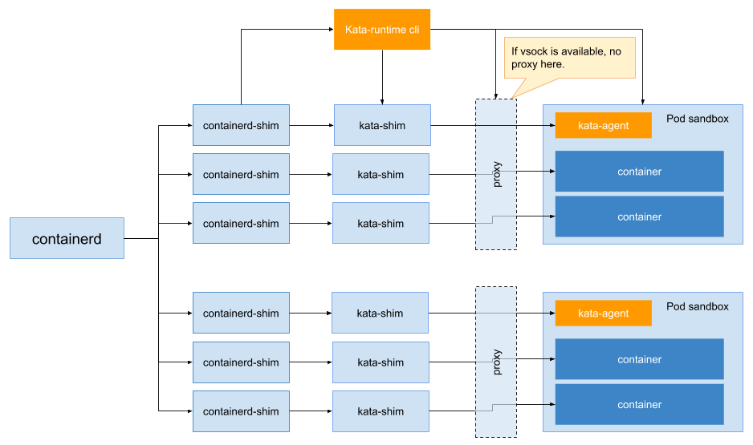
Too-MAAAANY-Shims!

Slide 13


Let There Be Light: containerd shimv2 API
containerd shim v2 grpc interfaces
containerd-shim-runc-v2
containerd-shim-kata-v2
containerd-shim-runsc-v2

Slide 14
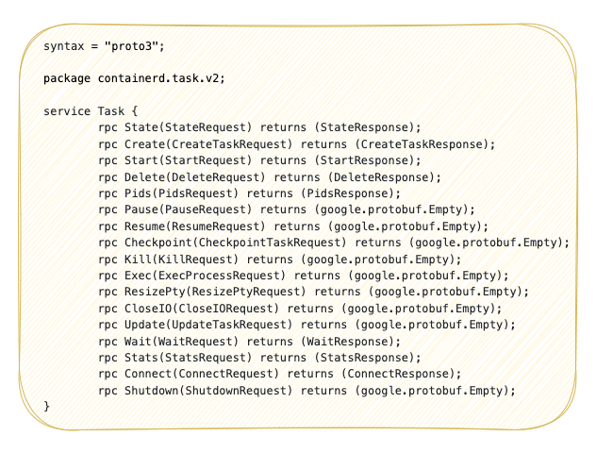
Let There Be Light: containerd shimv2 API
shim.v1.proto
shim.v2.proto

Slide 15
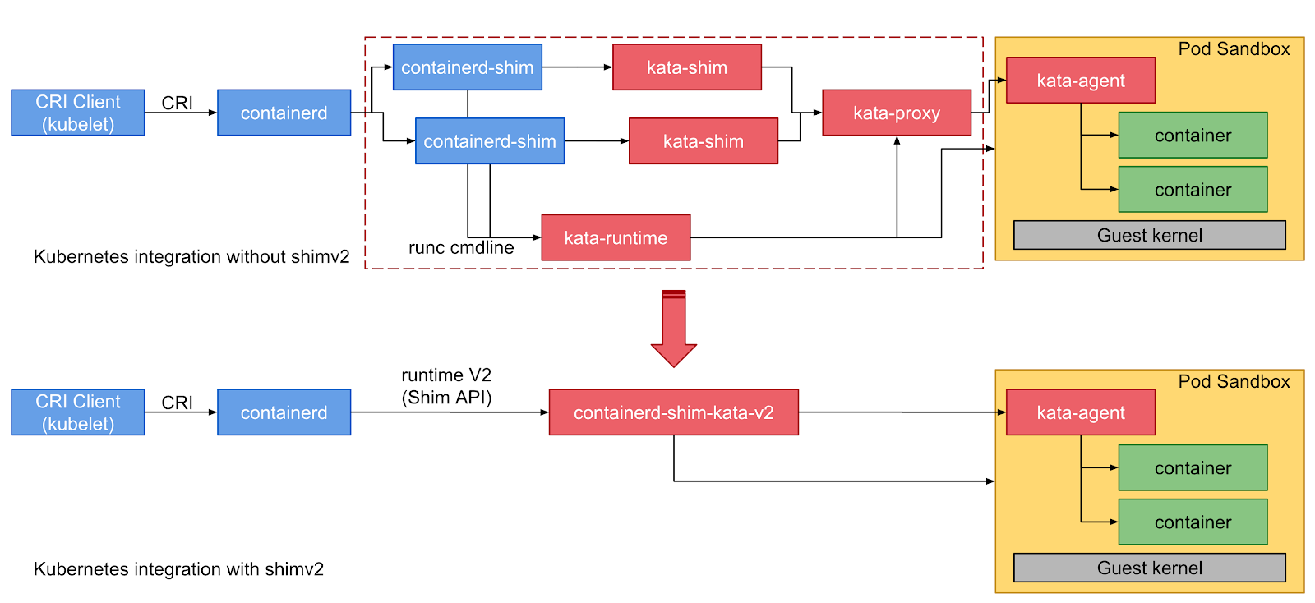
Kata Architecture Simplified (2018)

Slide 16
Benefits & Lingering Issues
Pros:
One shim per-pod
Much less GO process count
2 x Containers + 2 x Execs+ 1 x Proxy + 1 x Vmm -> 2 (shim + vmm)
Much Less memory overhead
Much easier to deploy
No more dangling shims
Leftovers:
Still one shim per-pod
Have to handle state inconsistency between shim and vmm process

Slide 17
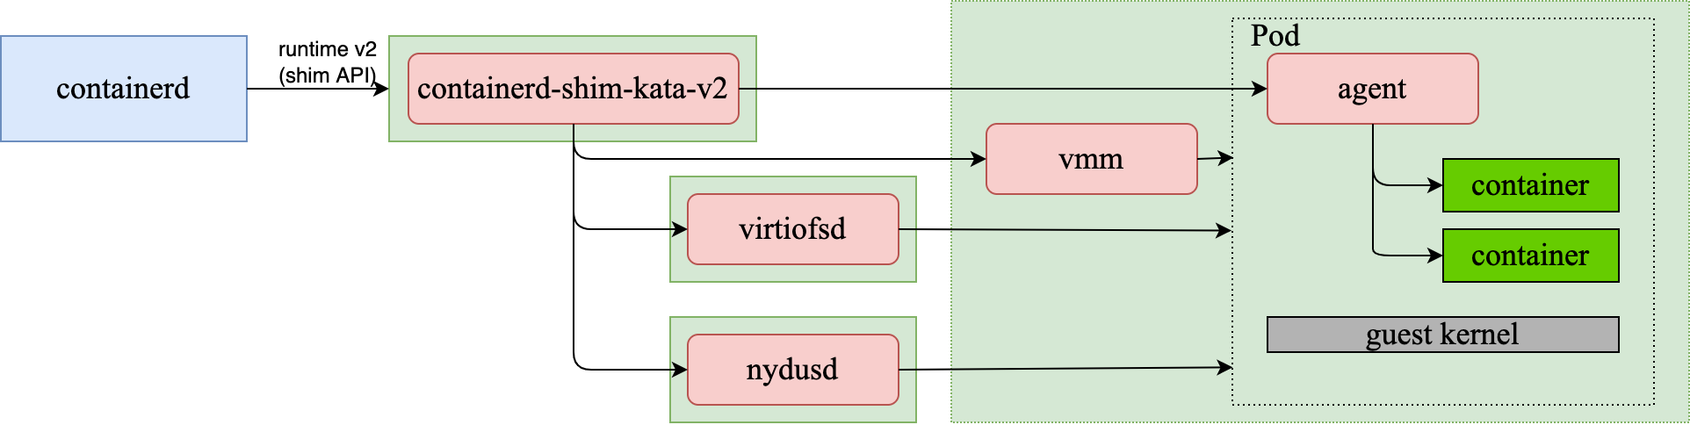
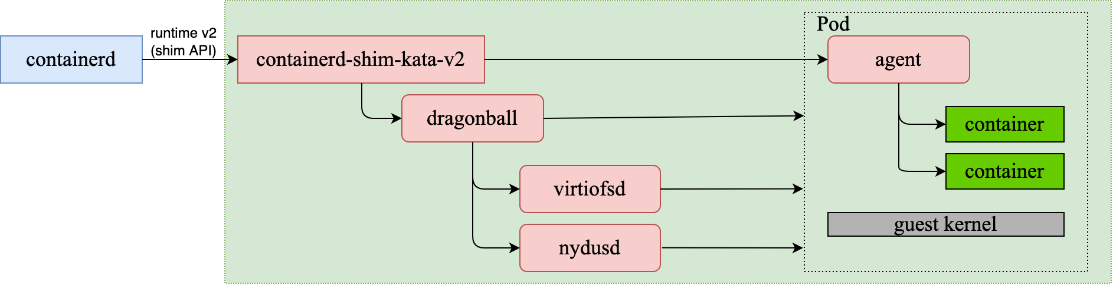
Kata 3.0 Architecture: A Step Forward
One process
Kata2.X
All-in-one process
Customized Designed
built-in VMM Dragonball
Kata3.0

Slide 18
Sandbox: A Hidden Figure
Sandbox was actually not a first class citizen in the containerd situation.
CRI
Shim v2
RunPodSandbox
StopPodSandbox
…
Start
Delete
…
No more
Sandbox concept here
Container and Sandbox concept are intertwined in Shim V2.
Kata Containers needs to infer sandbox ops from Shim V2.
Container ops
Sandbox ops inferred
From shim API

Slide 19
Sandbox: A Hidden Figure
Problem 1: Error-prone & Confusing
Single shim API could have multiple meanings, e.g. :
Create -> Create a sandbox and a pause container || Create a container in the sandbox
Delete -> Delete a container || Delete a container and the sandbox
Problem 2: Intertwined states
Containerd uses the same shim api to operate sandbox and container,
so different runtime has to build their own solution and solve same problems for managing sandboxes.
When there is unclarity, there lies opportunity.
So how to be better?
CRI
Task API
RunPodSandbox
StopPodSandbox
…
Sandbox API
Task API for container ops, Sandbox API for sandbox ops

Slide 20
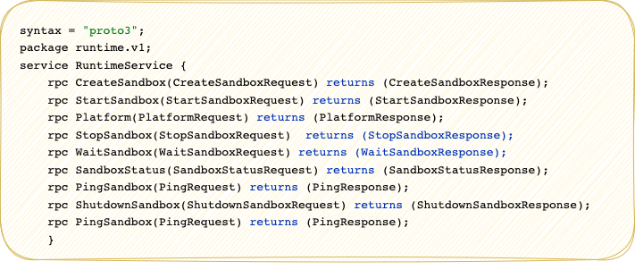
Let Sandbox be the first citizen
Containerd task interfaces
Containerd sandbox interfaces
containerd-shim-runc-v2
containerd-shim-kata-v2
containerd-shim-runsc-v2
* Introduced in containerd 1.7 as an experimental feature

Slide 21
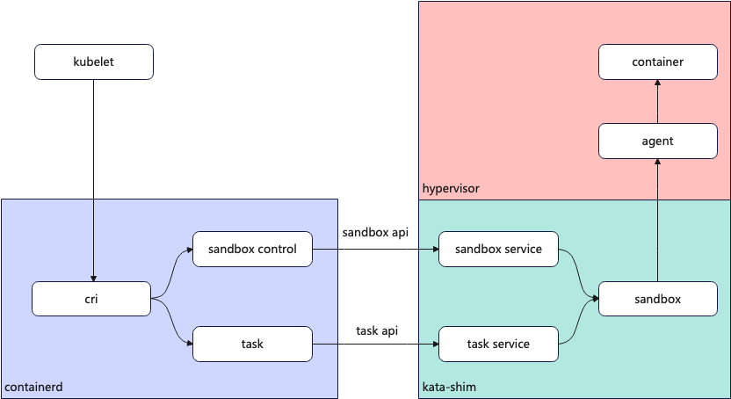
Sandbox API pushes arch transformation
Built-in Dragonball Case
Decouple Sandbox & Container Logics

Slide 22
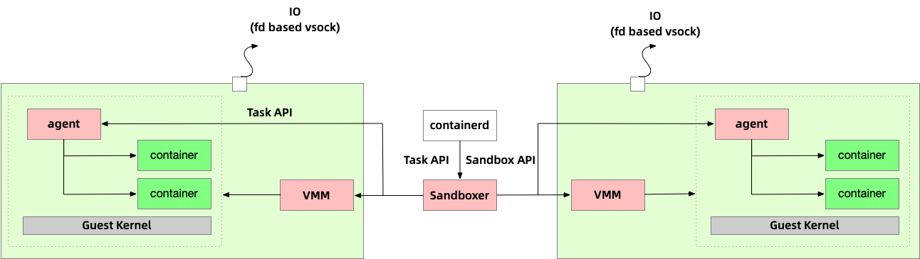
Sandbox API pushes arch transformation
Non built-in VMM case
No More shims
1:N sandboxer:pod model
IO through fd based vsock

Slide 23
Benefits & Performance
Pros:
No more intertwined logic with containers and sandbox (VM) management.
No more redundant pause container in Kata Containers when using Sandbox API.
Quicker startup time and less memory consumption with simplied architecture.
Kata 3 + Dragonball vs Kata 2 + QEMU
Test Item | Kata Container 3.0.0 | Kata Container 2.4.3
Single container boot up time | 354ms | 709ms
100 containers Memory consumption | 9,501,144KB | 18,001,884KB
1.8X
Lighter
2.0X
Faster

Slide 24
Summary
Shim V1
Shim V2
Sandbox API
The seemingly insignificant interfaces have witnessed the journey of cloud native development.

Slide 25
Kata Containers 3.0 X AI
Demo
Kata Containers 3.0 running Sandbox API

Slide 26
Kata Containers
Thank you
&
QA

